Slide 1
Helpdesk Integration
2020
Website Training Series
Cristopher Cravioto • Helpdesk Specialist at ACME Inc

Slide 2
1
Introduction
2
Features and Setup
3
Help Center
4
Livechat
5
Conclusion

Slide 3
Introduction
1

Slide 4
Helpdesk is going to be the bridge between you and your customers. It will allow you to connect with them and provide the services they deserve.

Slide 5
Features and Setup
2

Slide 6
Use Case / Features
Acme Inc ran into some problems with the laptops we had sold and needs ways to communicate effectively with their customers, some of the different helpdesk features we can use related to website are:
Contact Us Form
Tickets Form on Customer Portal
Help Center (Forum)
Coupons and Different After Sales
Livechat

Slide 7
Where to set them up?

Slide 8
Help Center
3

Slide 9
The forum currently runs as Odoo envisions their community to run - Self Moderated and community driven.
-Stephen Mack; 5,373 Karma points
Notes:
Here at Acme Inc we believe that the forum should run just like Odoo envisions their community to run – Self Moderated and community driven.

Slide 10
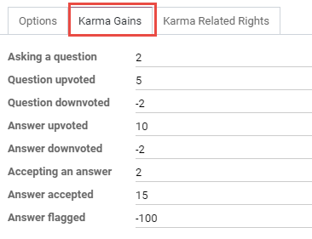
Help Center / Forum
Karma / Point System
Help centers in Odoo have a built in point system called “karma” where being active in the forum will award you points which unlock additional features in the forum.
Notes:
So since we want the forum to run this way and incentivize users to remain active we have set up the karma system in the following way.

Slide 11
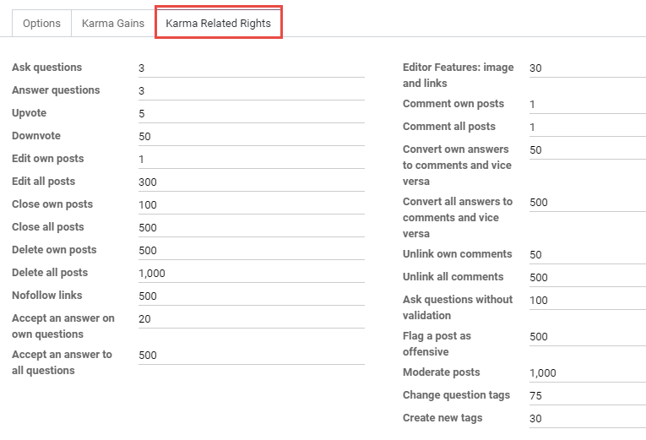
Help Center / Forum
Karma Related Rights

Slide 12
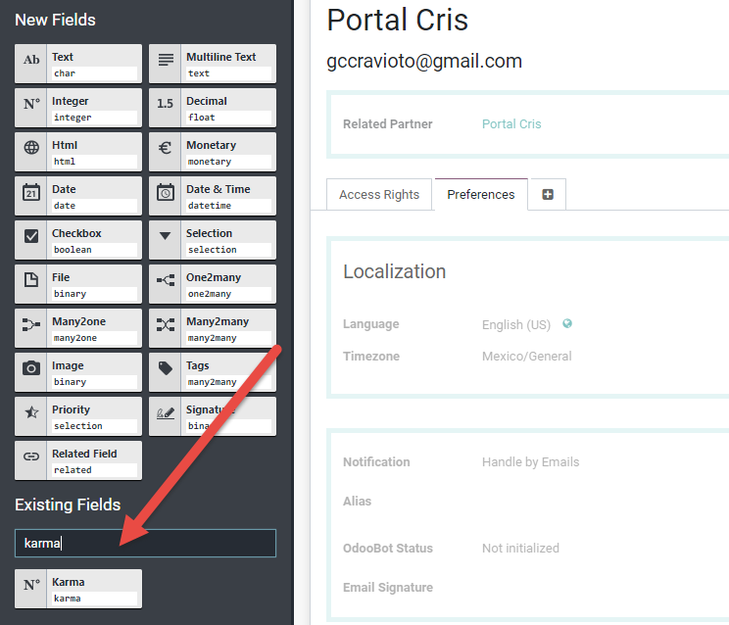
Help Center / Forum
Backend Forum Handling
If you would like grant karma to your employees so they can administrate the website or gain access to all features, you can add the “karma” field on the user page.

Slide 13
Help Center / Forum
Backend Forum Handling
If you would like grant karma to your employees so they can administrate the website or gain access to all features, you can add the “karma” field on the user page.

Slide 14
Livechat
4

Slide 15
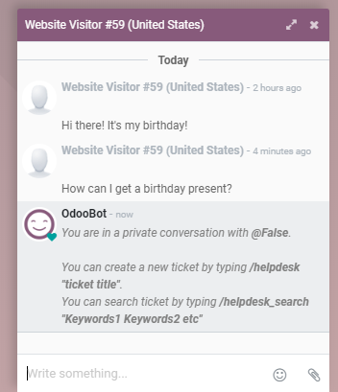
Livechat
Creating a ticket
People assigned to livechat channels can access several commands from the chat window, these can help them create a helpdesk ticket or search for an existing one.

Slide 16
Livechat
Ticket created from the chat:
They will keep the conversation in the body of the ticket. Followers of the ticket will be sent an email and portal users can then follow any tickets on their portal page.

Slide 17
Get Your Tickets In!
Database: https://acme-inc1.odoo.com/
Livechat link: https://acme-inc1.odoo.com/im_livechat/support/2
Helpdesk team mail alias: support@acme-inc1.odoo.com
Notes:
https://acme-inc1.odoo.com/im_livechat/support/2
https://acme-inc1.odoo.com/
support@acme-inc1.odoo.com

Slide 18
Conclusion
5

Slide 19
Conclusion
Thanks to all the different channels and tools provided by our helpdesk platform, ACME Inc has provided solutions to all angry customers and has kept them happy, this is very important for them since ACME Inc believes that customer satisfaction will provide a lot more MRR in the future.

Slide 20
Thank you.
2020
https://survey.odoo.com/survey/start/39d27ed5-177c-4f31-99e5-4a5a273be7fa
Notes:
https://survey.odoo.com/survey/start/39d27ed5-177c-4f31-99e5-4a5a273be7fa

